Slide 1
Instructions:
The following PowerPoint contains all the necessary information to determine the identity of one bacteria. Following the prompts, click on the step you would like to follow. This will direct you to the results of that media or test. Make sure to be keeping detailed notes of each step you follow as you will still be required to turn in a detailed write up outlining your evidence.
Click to Follow

Slide 2
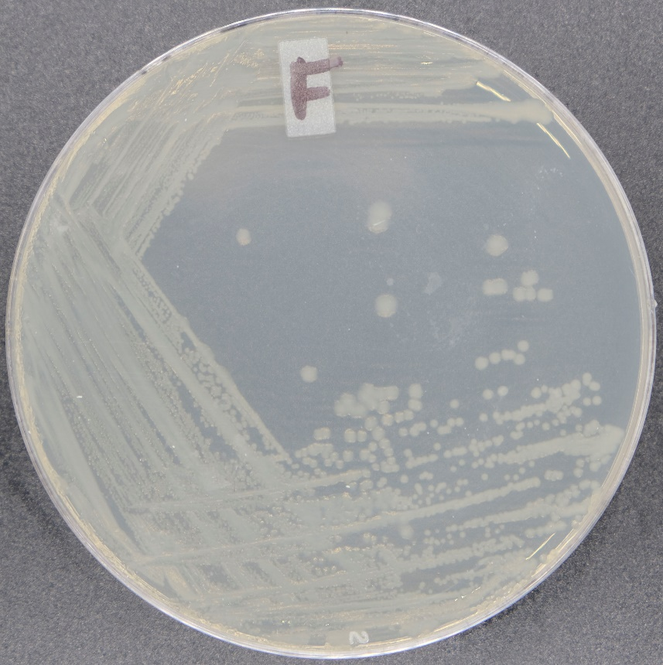

You plate your bacteria on a NA plate and receive the following growth.
You then perform a Gram Stain and view your slide using the 100x objective on your microscope.
Please choose the proper Gram Result to move forward.
Gram Positive
Gram Negative

Slide 3
Gram Positive Test Options:
MSA
PEA
Blood
Bile
Other Options
Finish

Slide 4
Gram Negative Test Options:
TSI
Motility
MAC
HEK
EMB
Citrate
Other Options
Finish

Slide 5
Other Test Options:
Coagulase Test
Catalase Test
Endospore Stain
Capsule Stain
Simple Stain
Negative Stain
All
Options
Finish

Slide 6
All Test Options:
MSA
PEA
Blood
Bile
MAC
EMB
HEK
TSI
Motility
Citrate
Capsule Stain
Simple Stain
Negative Stain
Coagulase Test
Endospore Stain
Catalase Test
Finish

Slide 7
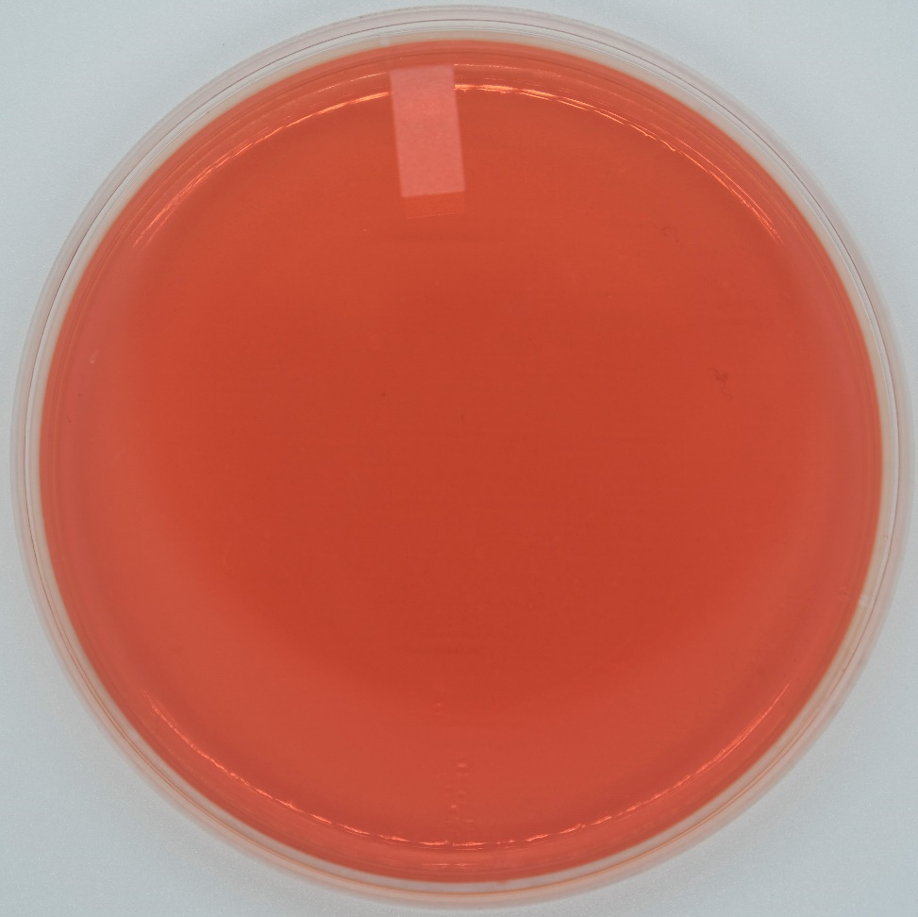
MSA Results:
Gram Positive Test Options
Gram Negative Test Options
Other Test Options
All Test Options
Finish

Slide 8
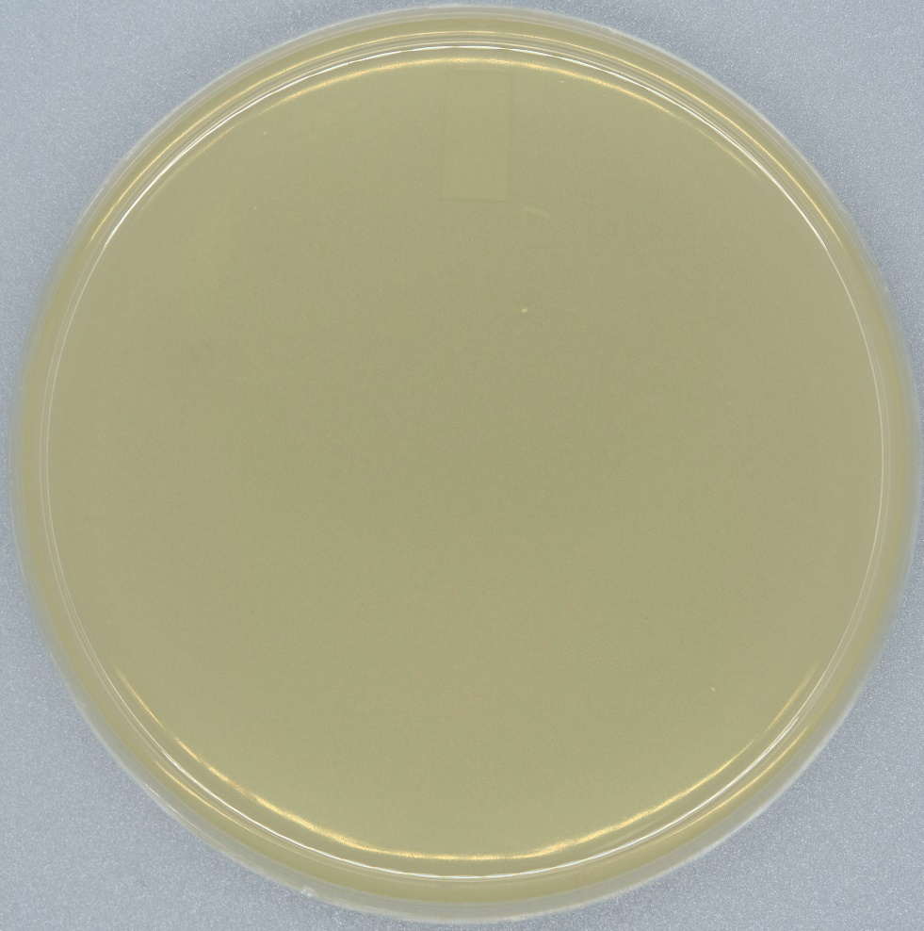
PEA Results:
Gram Positive Test Options
Gram Negative Test Options
Other Test Options
All Test Options
Finish

Slide 9
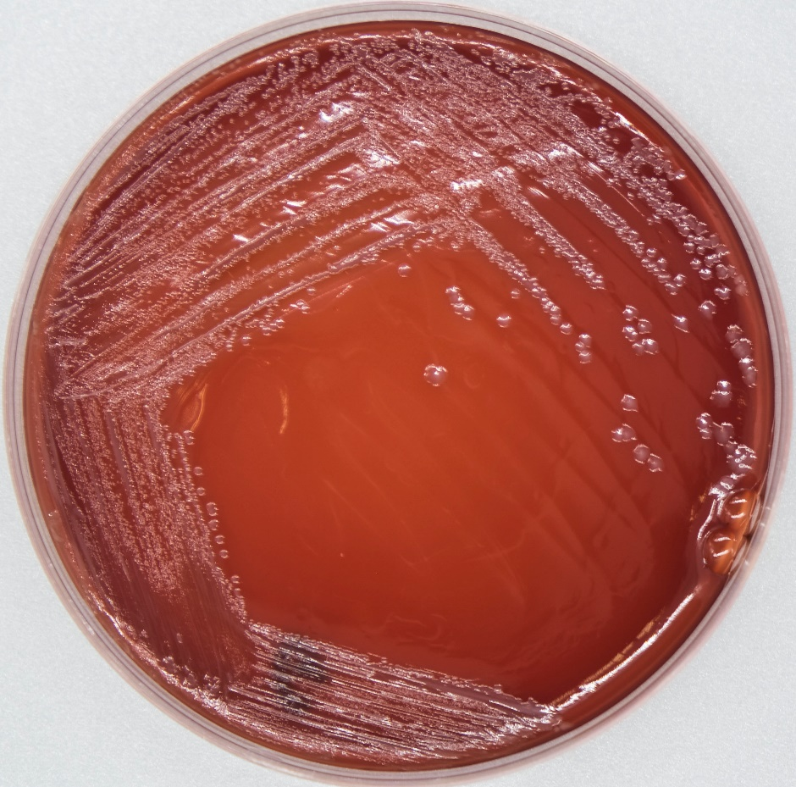
Blood Results:
Gram Positive Test Options
Gram Negative Test Options
Other Test Options
All Test Options
Finish

Slide 10
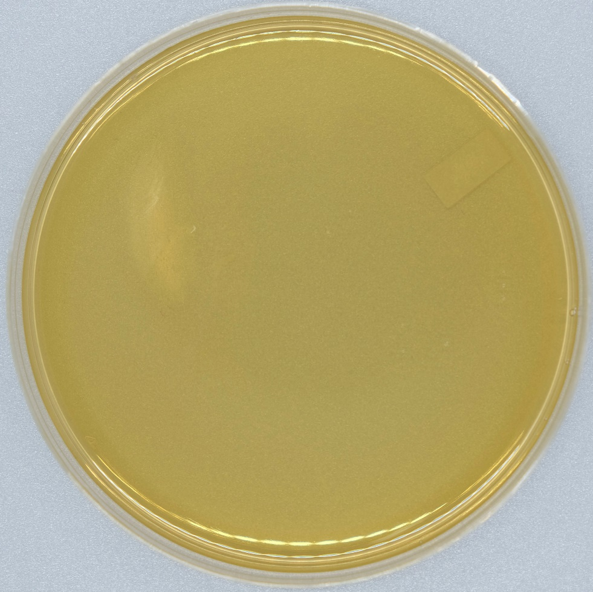
Bile Results:
Gram Positive Test Options
Gram Negative Test Options
Other Test Options
All Test Options
Finish

Slide 11
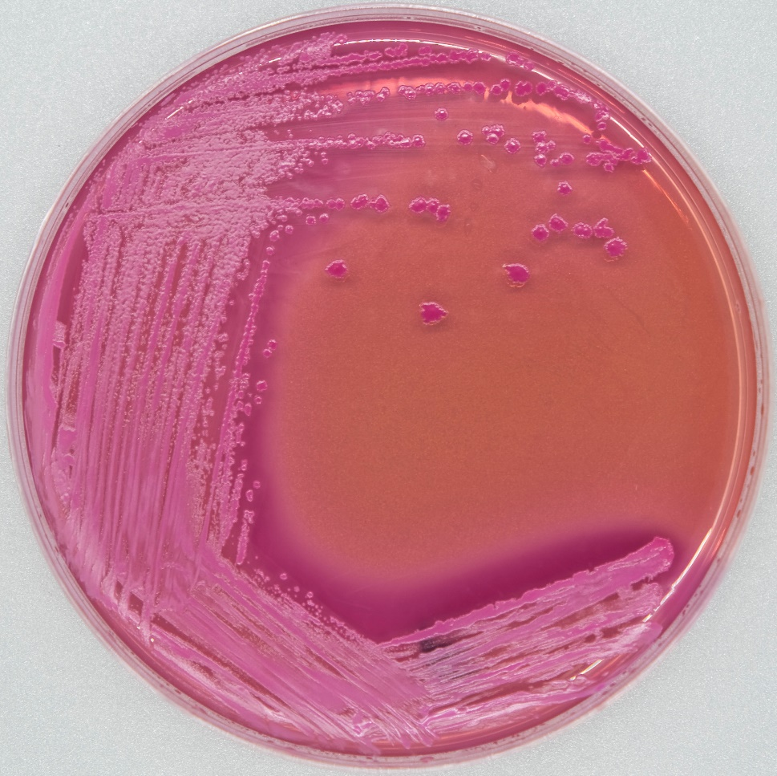
MAC Results:
Gram Positive Test Options
Gram Negative Test Options
Other Test Options
All Test Options
Finish

Slide 12
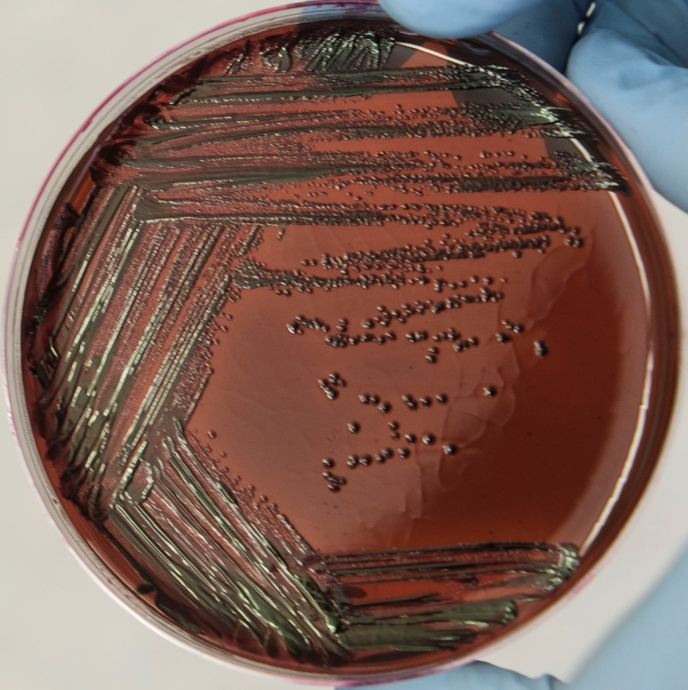
EMB Results:
Gram Positive Test Options
Gram Negative Test Options
Other Test Options
All Test Options
Finish

Slide 13
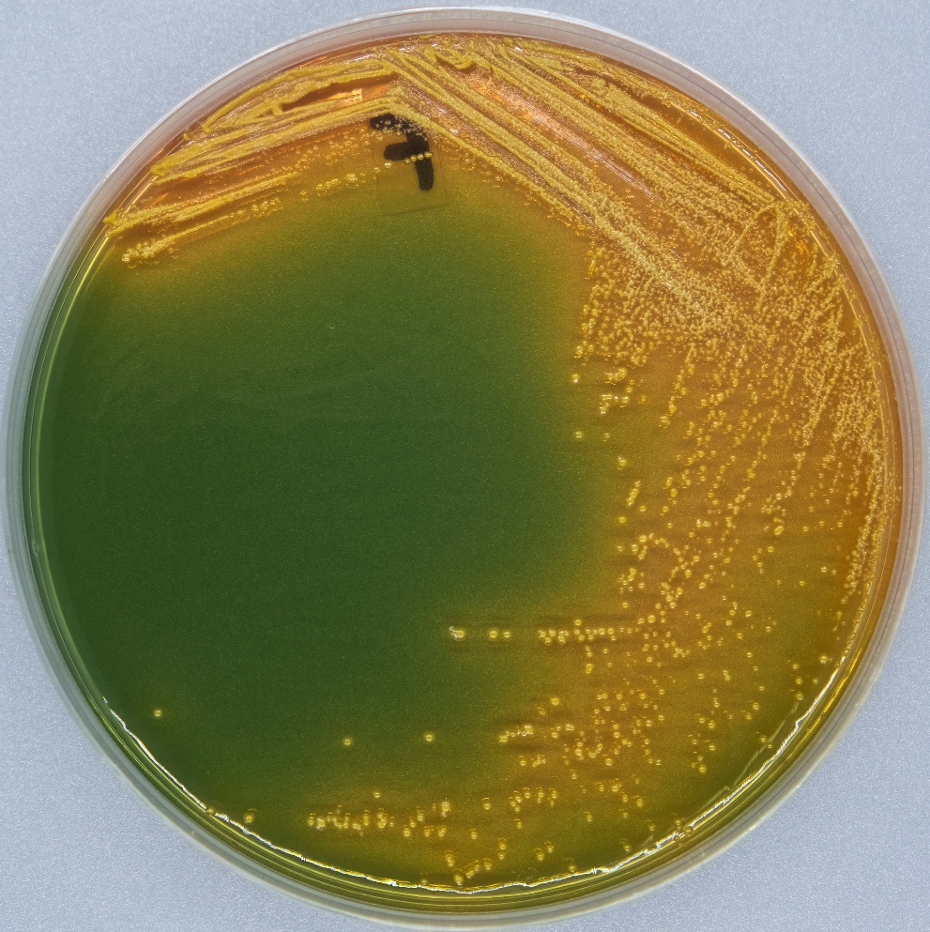
HEK Results:
Gram Positive Test Options
Gram Negative Test Options
Other Test Options
All Test Options
Finish

Slide 14
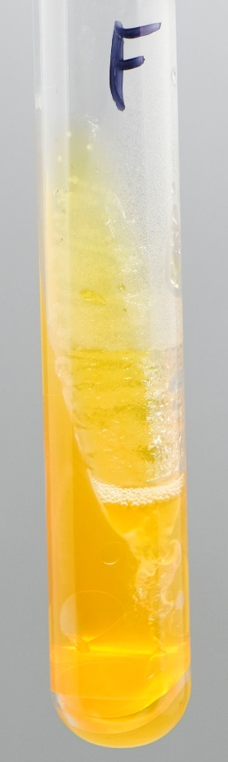
TSI Results:
Gram Positive Test Options
Gram Negative Test Options
Other Test Options
All Test Options
Finish

Slide 15
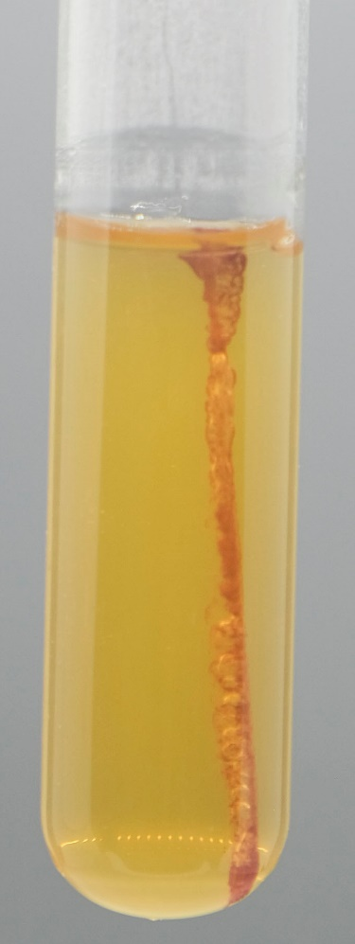
Motility Results:
Gram Positive Test Options
Gram Negative Test Options
Other Test Options
All Test Options
Finish

Slide 16
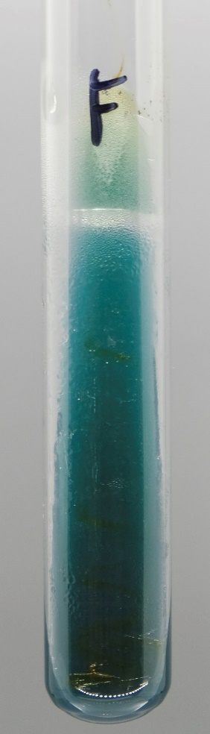
Citrate Results:
Gram Positive Test Options
Gram Negative Test Options
Other Test Options
All Test Options
Finish

Slide 17
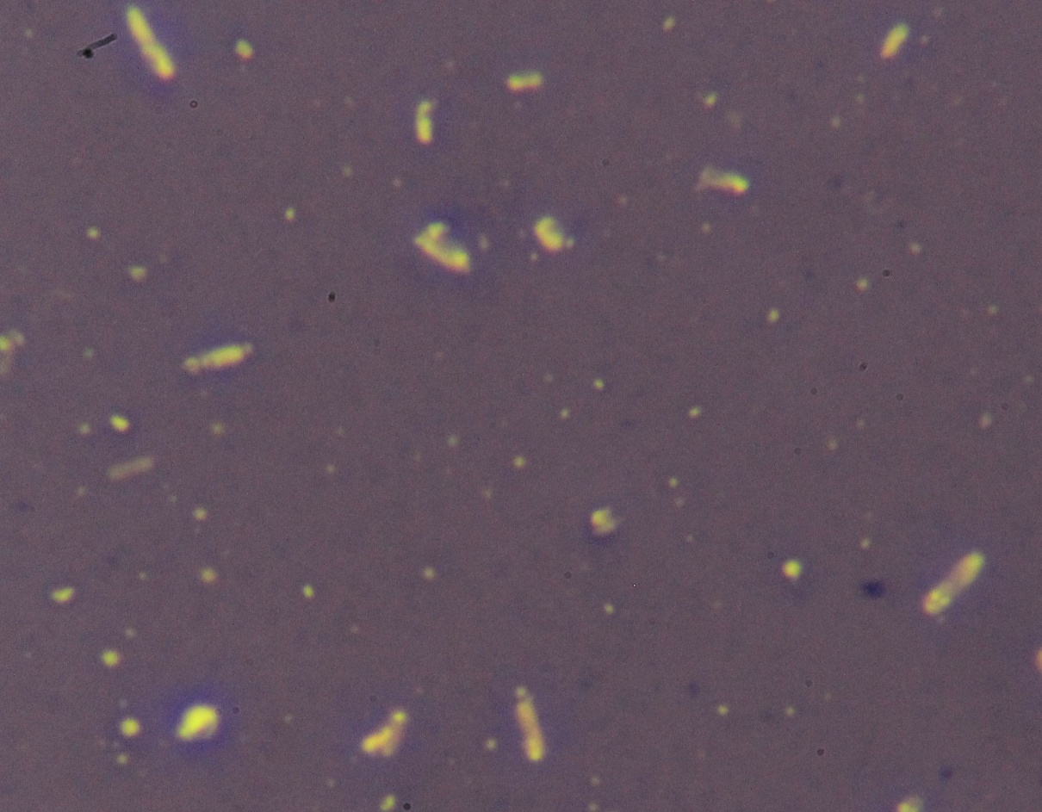
Capsule Stain Results:
Gram Positive Test Options
Gram Negative Test Options
Other Test Options
All Test Options
Finish

Slide 18
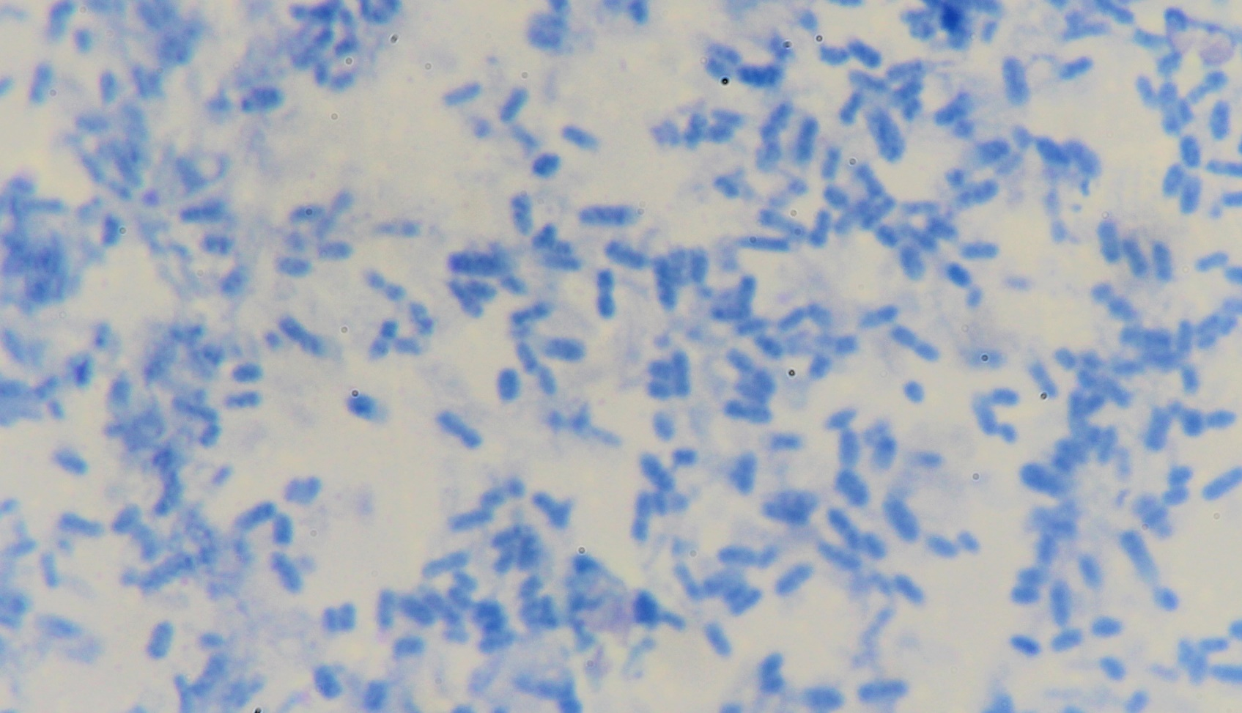
Simple Stain Results:
Gram Positive Test Options
Gram Negative Test Options
Other Test Options
All Test Options
Finish

Slide 19
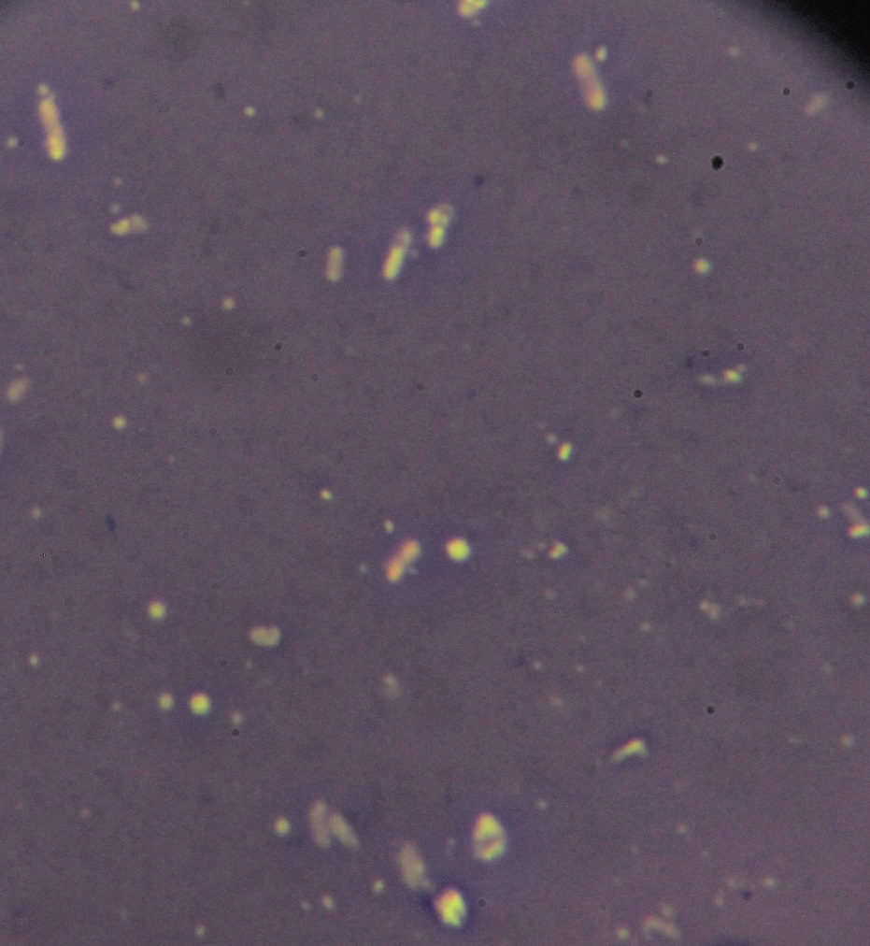
Negative Stain Results:
Gram Positive Test Options
Gram Negative Test Options
Other Test Options
All Test Options
Finish

Slide 20
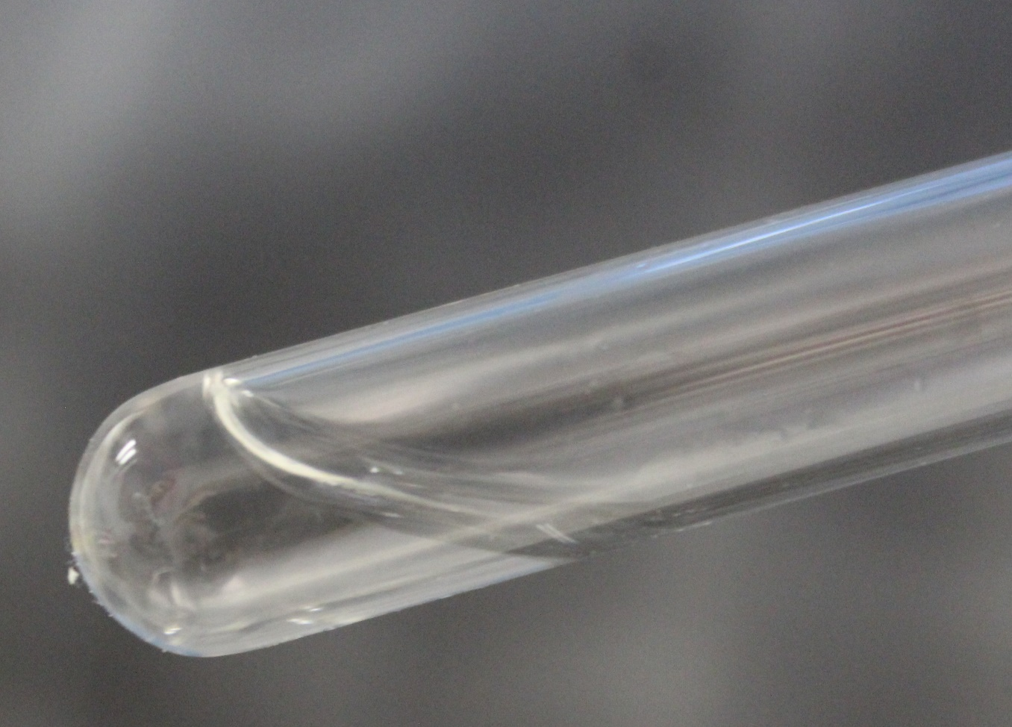
Coagulase Test Results:
Gram Positive Test Options
Gram Negative Test Options
Other Test Options
All Test Options
Finish

Slide 21
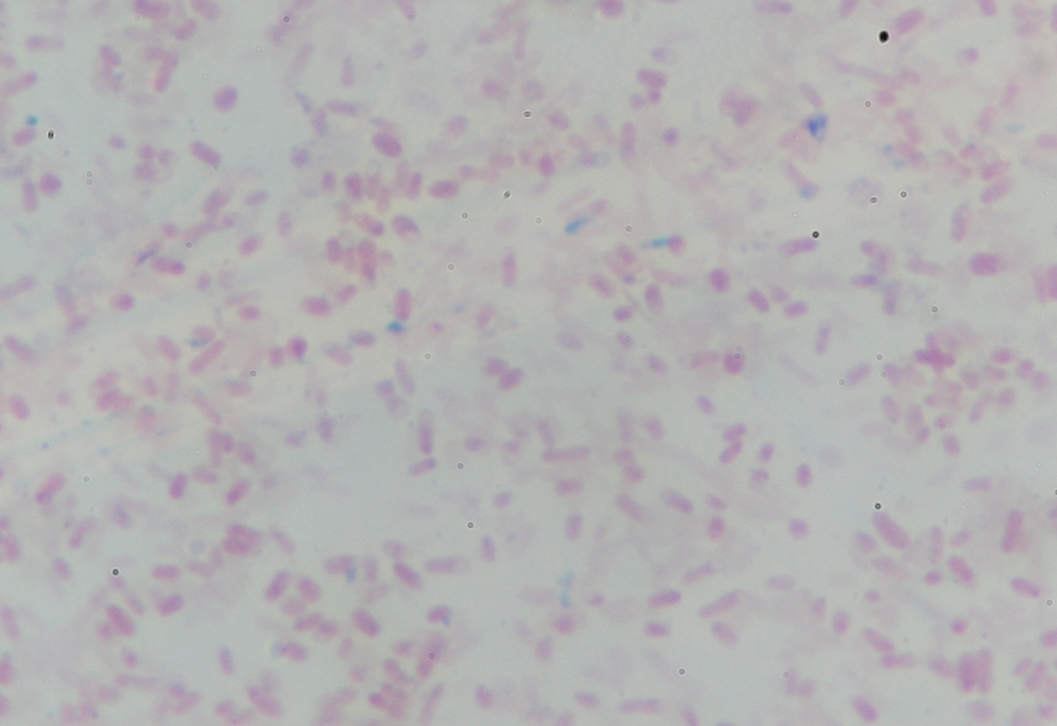
Endospore Stain Results:
Gram Positive Test Options
Gram Negative Test Options
Other Test Options
All Test Options
Finish

Slide 22
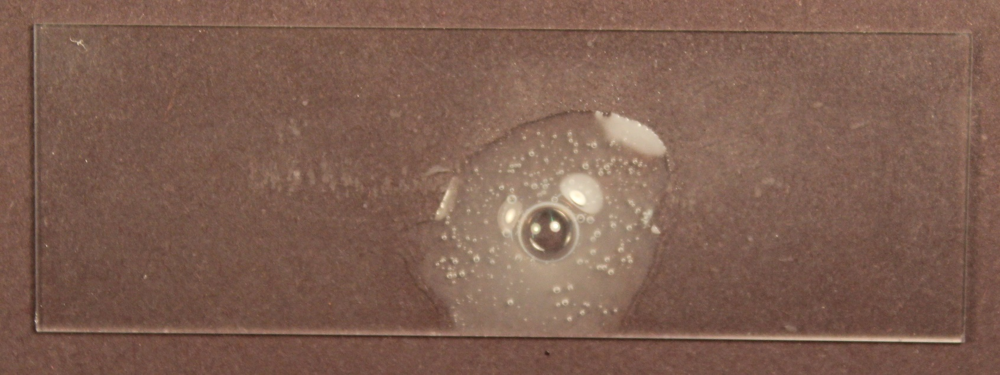
Catalase Test Results:
Gram Positive Test Options
Gram Negative Test Options
Other Test Options
All Test Options
Finish

Slide 23
You have forwarded without clicking the embedded link. Please click below to return to the beginning.
Start

Slide 24
Would you like to perform any other tests?
YES
NO

Slide 25
Congratulations!
You have reached the end of the simulation. Press FINISH to end the show. Press START to return to the beginning.
Finish
Start

